Slide 1


Slide 2
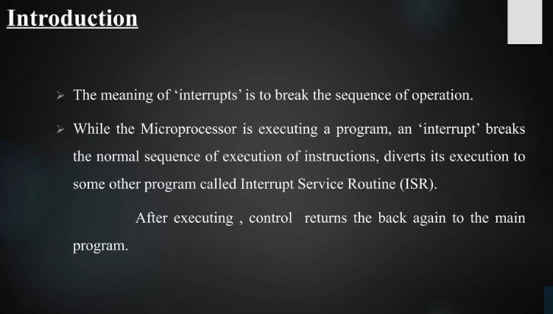

Slide 3
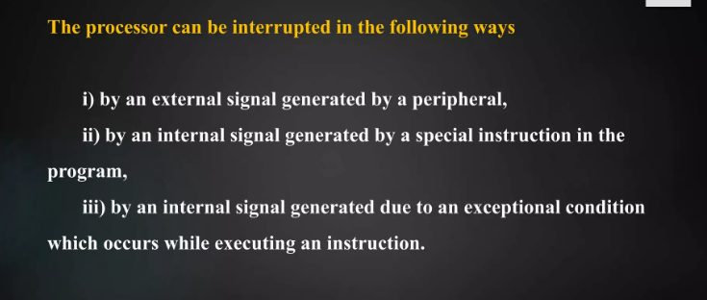

Slide 4
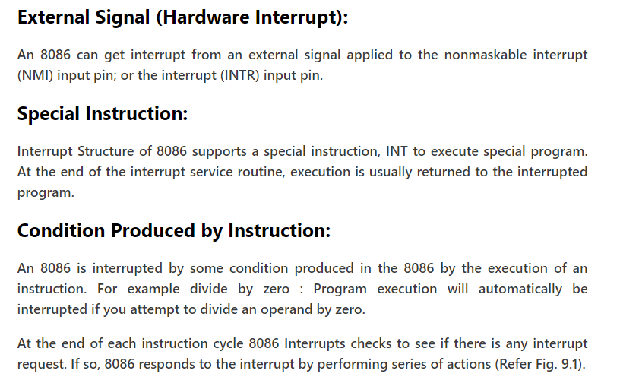

Slide 5
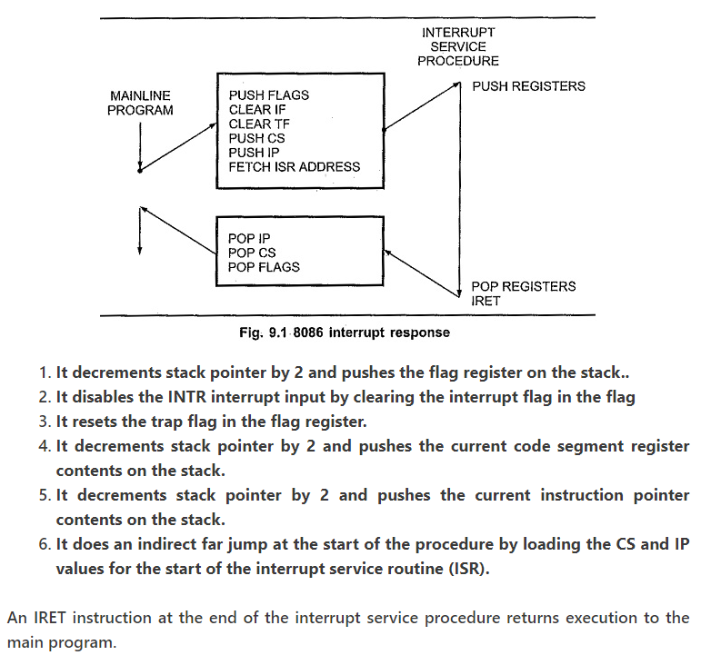

Slide 6
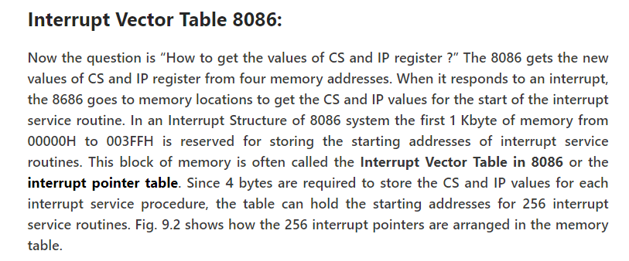

Slide 7
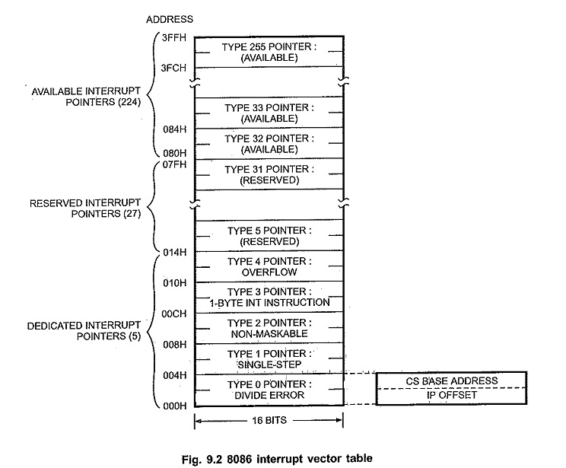

Slide 8
Each interrupt type is given a number between 0 to 255 and the address of each interrupt js found by multiplying the type by 4 e.g. for type 11, interrupt address is 11 x 4 = 44₁₀= 0002CH
Only first five types have explicit definitions such as divide by zero and non maskable interrupt. The next 27 interrupt types, from 5 to 31, are reserved by Intel for use in future microprocessors. The upper 224 interrupt types, from 32 to 255, are available for user for hardware or software interrupts.
When the 8086 responds to an interrupt, it automatically goes to the specified location in the Interrupt Vector Table in 8086 to get the starting address of interrupt service routine. So user has to load these starting addresses for different routines at the start of the program.

Slide 9
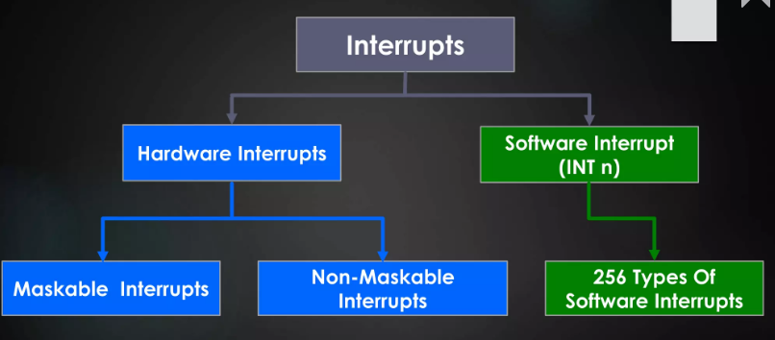

Slide 10
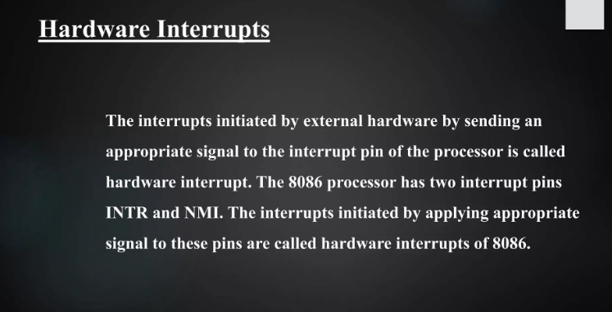

Slide 11
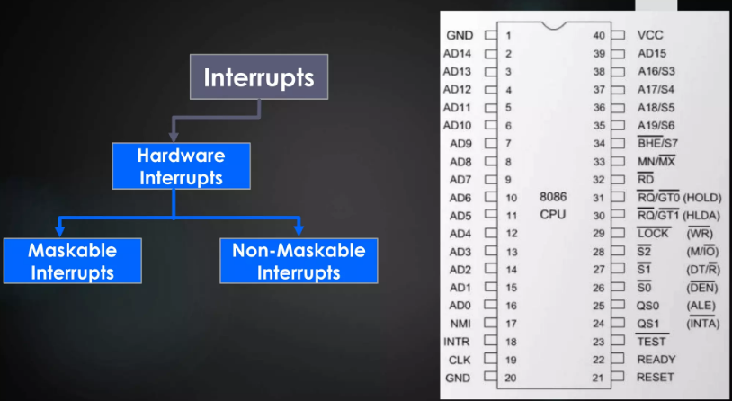

Slide 12
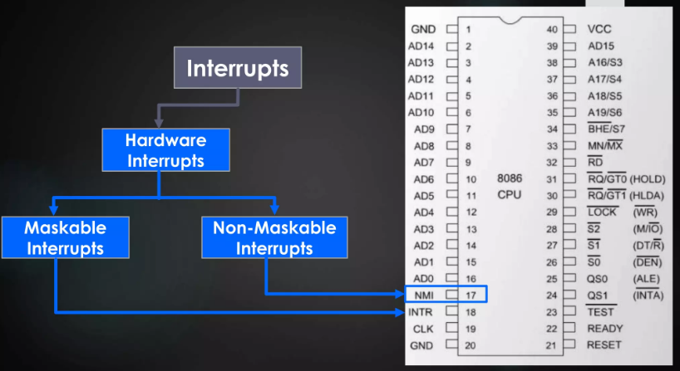

Slide 13


Slide 14
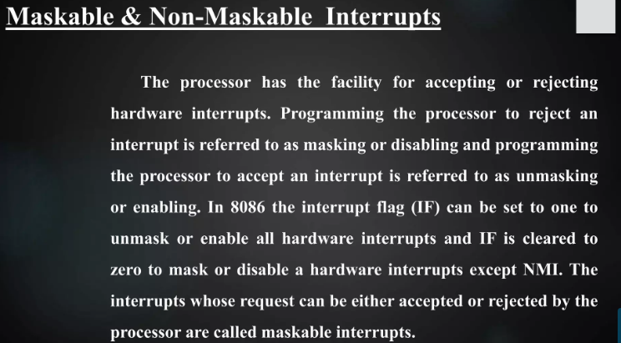

Slide 15
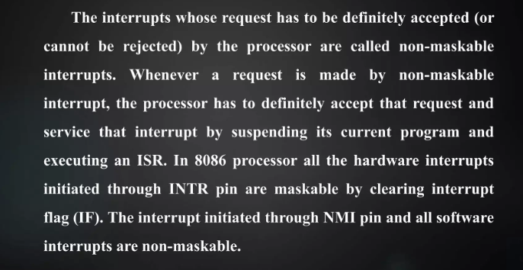

Slide 16
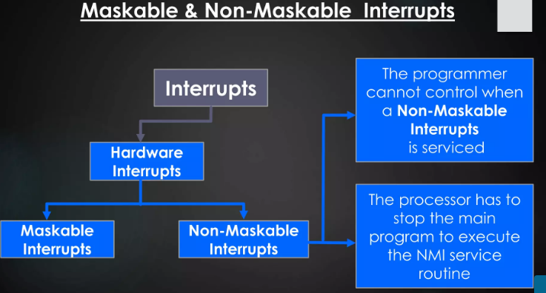

Slide 17
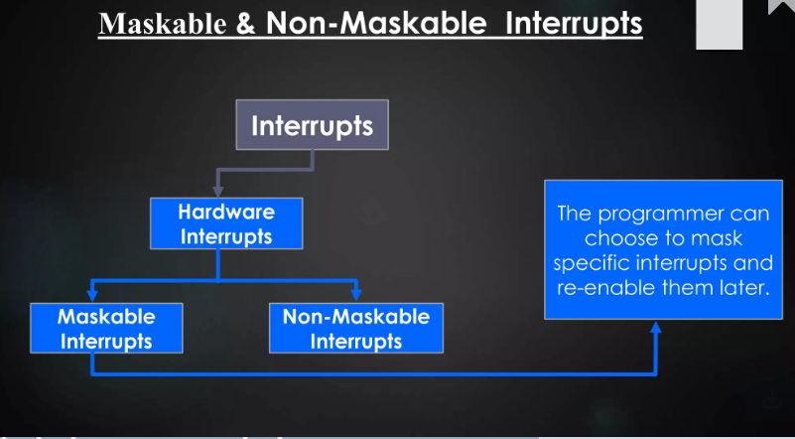

Slide 18
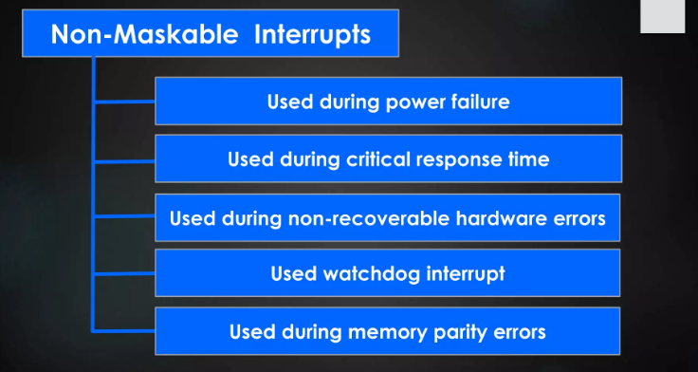

Slide 19
NMI (Non mask-able interrupt)-
This is a non-mask-able, edge triggered, high priority interrupt.
On receiving an interrupt on NMI line, the microprocessor executes INT
Microprocessor obtains the ISR address from location 2 x 4 = 00008H from the IVT.
It reads 4 locations starting from this address to get the values for IP and CS to execute the ISR.
INTR-
This is a mask-able, level triggered, low priority interrupt.
On receiving an interrupt on INTR line, the microprocessor executes 2 INTA¯¯¯¯¯¯¯¯¯¯¯¯¯¯INTA¯ pulses.
1st INTA¯¯¯¯¯¯¯¯¯¯¯¯¯¯INTA¯ pulse – The interrupting device calculates (prepares to send) the vector number.
2nd INTA¯¯¯¯¯¯¯¯¯¯¯¯¯¯INTA¯ pulse – The interrupting device sends the vector number ‘N’ to the microprocessor.
Now microprocessor multiplies N x 4 and goes to the corresponding location in the IVT to obtain the ISR address. INTR is a mask-able interrupt.
It is masked by making IF = 0 by software through CLI instruction.
It is unmasked by making IF = 1 by software through STI instruction.

Slide 20
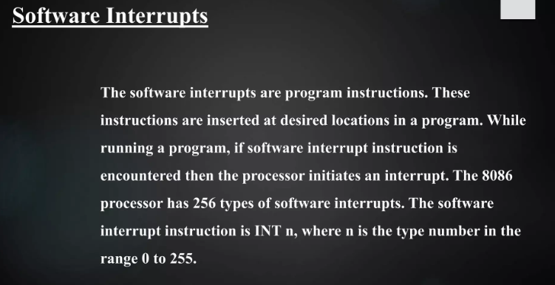

Slide 21
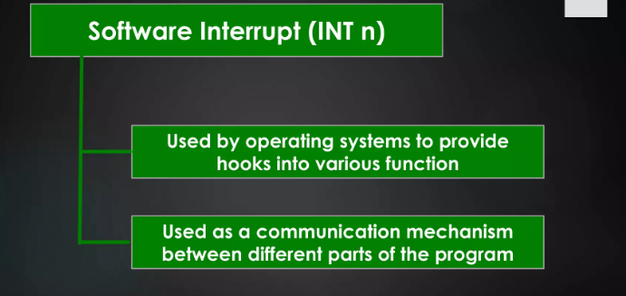

Slide 22
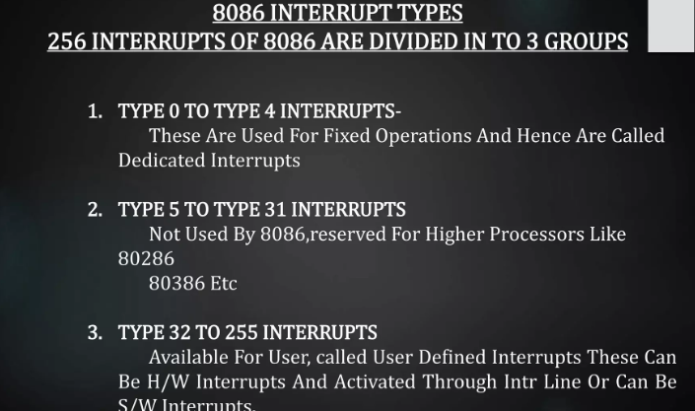

Slide 23
The interrupt vector (or interrupt pointer) table is the link between an interrupt type code and the procedure that has been designated to service interrupts associated with that code. 8086 supports total 256 types i.e. 00H to FFH.
For each type it has to reserve four bytes i.e. double word. This double word pointer contains the address of the procedure that is to service interrupts of that type.
The higher addressed word of the pointer contains the base address of the segment containing the procedure. This base address of the segment is normally referred as NEW CS.
The lower addressed word contains the procedure’s offset from the beginning of the segment. This offset is normally referred as NEW IP.
Thus NEW CS: NEW IP provides NEW physical address from where user ISR routine will start.
As for each type, four bytes (2 for NEW CS and 2 for NEW IP) are required; therefore interrupt pointer table occupies up to the first 1k bytes (i.e. 256 x 4 = 1024 bytes) of low memory.
The total interrupt vector table is divided into three groups namely,
A. Dedicated interrupts (INT 0…..INT 4)
B. Reserved interrupts (INT 5…..INT 31)
C. Available interrupts (INT 32…..INT 225)

Slide 24
A. Dedicated interrupts (INT 0…..INT 4):
INT 0 (Divide Error)-
This interrupt occurs whenever there is division error i.e. when the result of a division is too large to be stored. This condition normally occurs when the divisor is very small as compared to the dividend or the divisor is zero.
Its ISR address is stored at location 0 x 4 = 00000H in the IVT.
INT 1 (Single Step)-
The microprocessor executes this interrupt after every instruction if the TF is set.
It puts microprocessor in single stepping mode i.e. the microprocessor pauses after executing every instruction. This is very useful during debugging.
Its ISR generally displays contents of all registers. Its ISR address is stored at location 1 x 4 = 00004H in the IVT.
INT 2 (Non mask-able Interrupt)-
The microprocessor executes this ISR in response to an interrupt on the NMI (Non mask-able Interrupt) line.
Its ISR address is stored at location 2 x 4 = 00008H in the IVT.
INT 3 (Breakpoint Interrupt)-
This interrupt is used to cause breakpoints in the program. It is caused by writing the instruction INT 03H or simply INT.
It is useful in debugging large programs where single stepping is efficient.
Its ISR is used to display the contents of all registers on the screen. Its ISR address is stored at location 3 x 4 = 0000CH in the IVT.

Slide 25
INT 4 (Overflow Interrupt)-
This interrupt occurs if the overflow flag is set and the microprocessor executes the INTO (Interrupt on Overflow) instruction.
It is used to detect overflow error in signed arithmetic operations.
Its ISR address is stored at location 4 x 4 = 00010H in the IVT.
B. Reserved interrupts (INT 5…..INT 31):
These levels are reserved by Intel to be used in higher processors like 80386, Pentium etc. They are not available to the user.
C. Available interrupts (INT 32…..INT 225):
These are user defined, software interrupts.
ISRs for these interrupts are written by the users to service various user defined conditions.
These interrupts are invoked by writing the instruction INT n. Its ISR address is obtained by the microprocessor from location n x 4 in the IVT.

